Slide 1
Snowflake - Session
DAY 4

Slide 2
Agenda:
What is cloning
What objects can be cloned
Cloning using time travel
Time Travel
Fail Safe

Slide 3
Zero Copy Cloning
Snowflake cloning reproduces data from a schema, database or table without the need for additional storage.
Uses metadata of original table to avoid additional storage
When you clone a database all schemas and tables in that database will also be cloned.
When you clone a schema all tables in that schema will also be cloned.
Example
Create table cloned_table_name clone original_table_name

Slide 4
Objects can be cloned:
data storage objects:
databases
schemas
tables(external tables cannot be cloned)
Streams
data configuration and transformation objects:
Stages(internal named stage cannot be cloned)
file formats
sequences
Tasks

Slide 5
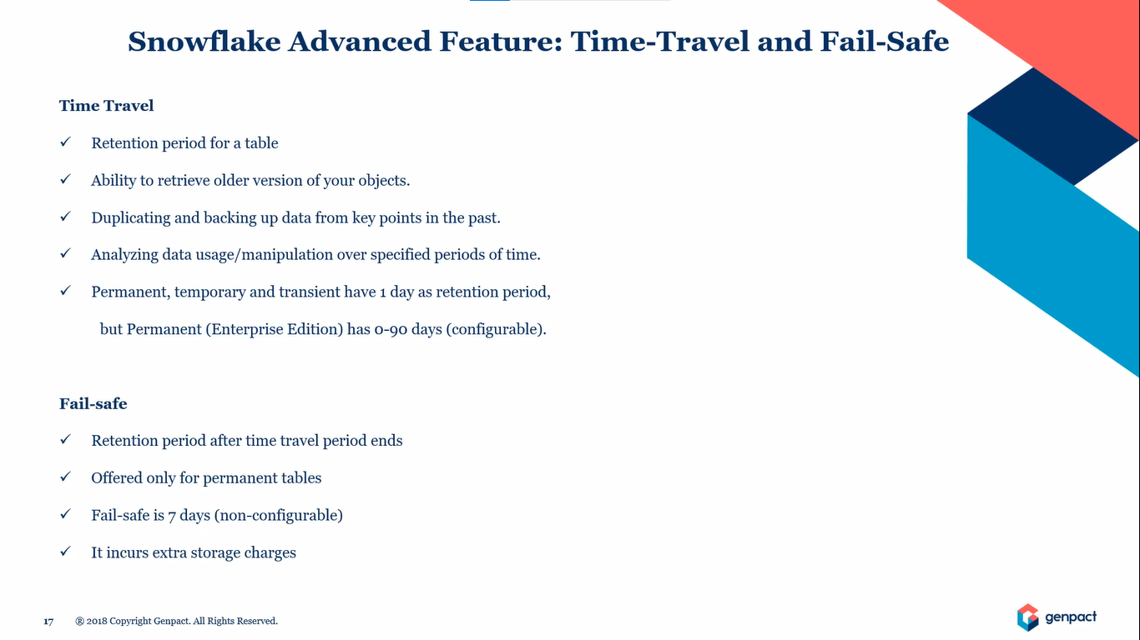

Slide 6
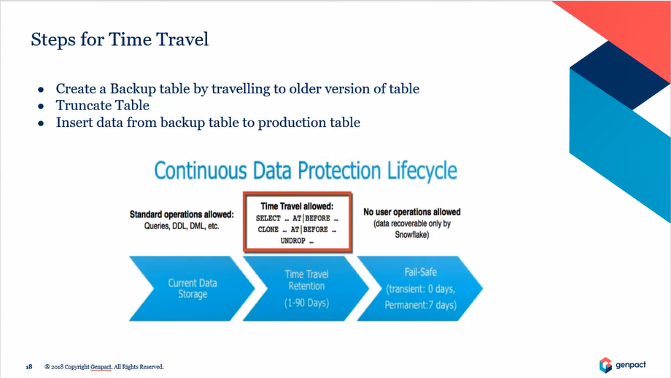
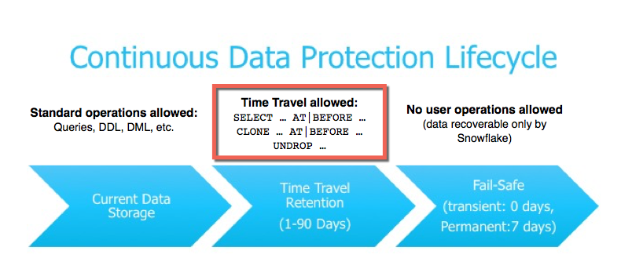

Slide 7
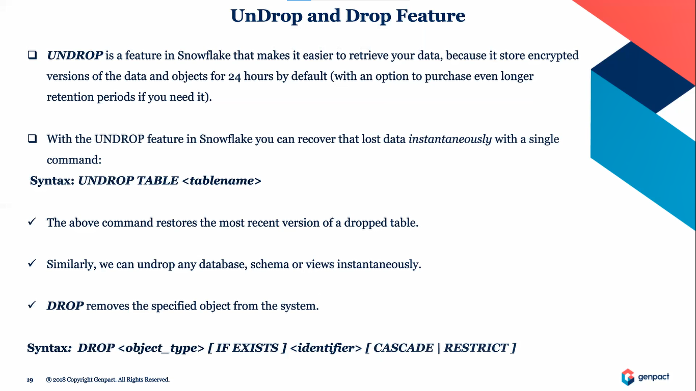

Slide 8
Cloning Using Time Travel
We can clone using Time Travel using 3 different ways:
OFFSET:- create table r1 clone patient at(offset=>-60*3);
TIMESTAMP:- create table r2 clone patient at(timestamp=>’2022-12-10 08:43:08.810 -0800’ ::timestamp);
QUERY ID:- create table r3 clone patient before(statement=>’01g38848-0000-h656-3jf4j5j3j53j’);

